Slide 1

LG&E SAP S/4 HANA Project Intro to LG&E Electronics
Linde Confidential

Slide 2
LG&E Electronics Business
Approximately $0.5B in Sales/Year
Electronics Specialty Gases Business~ $380M
Electronics Logistics Business ~ $120M
Government Lab Business…
Approximately 460 Employees
370 SAP users
5 Production Plants
1 Lab
15 Warehouses
Other
Bulk He
Equip
SiH4
PH3
D2
GeH4
SF6
Xe
Bulk CO2
WF6
H2SiCl2
NF3
Si2H6
B2H6
HF
N2O
Halocarbons
11BF3
HCl
NH3
UpTime
C4F8
He3
HCl3Si
Excimer
Rent

Slide 3
Electronics Locations
ESG Plant
Alpha, NJ
ESG Plant
Medford, OR
Ne,Kr,Xe purification
Inert & litho mixes
Halocarbon distillation
He₃ purification
B₁₁F₃ Separation
F₂ Synthesis
Si₂H₆ Purification
CO₂ Purification
Corrosives Distillation
Government Lab
New Providence, NJ
USAF Contract Support
(details confidential)
ESG Plant
Kingman, AZ
Office – Headquarters
Hampton, NJ (Jan 2021)
Arsine
Phosphine
NH₃ Iso’s
N₂O Tube Trailers
Leadership Team
Customer Service
Logistics
SHEQ
ESG Plant
Phoenix, AZ
Electronics Logistics
Phoenix, AZ
ESG Plant
RTP, NC
Equipment Ctr
Lopatcong, NJ
HCl Transfill
NH₃ Distillation
Warehouse
D₂ Synthesis
N₂O Distillation
Metallic Hydride Mixes
New Site Q3 16
Clean rooms 17
Amplify packs

Slide 4
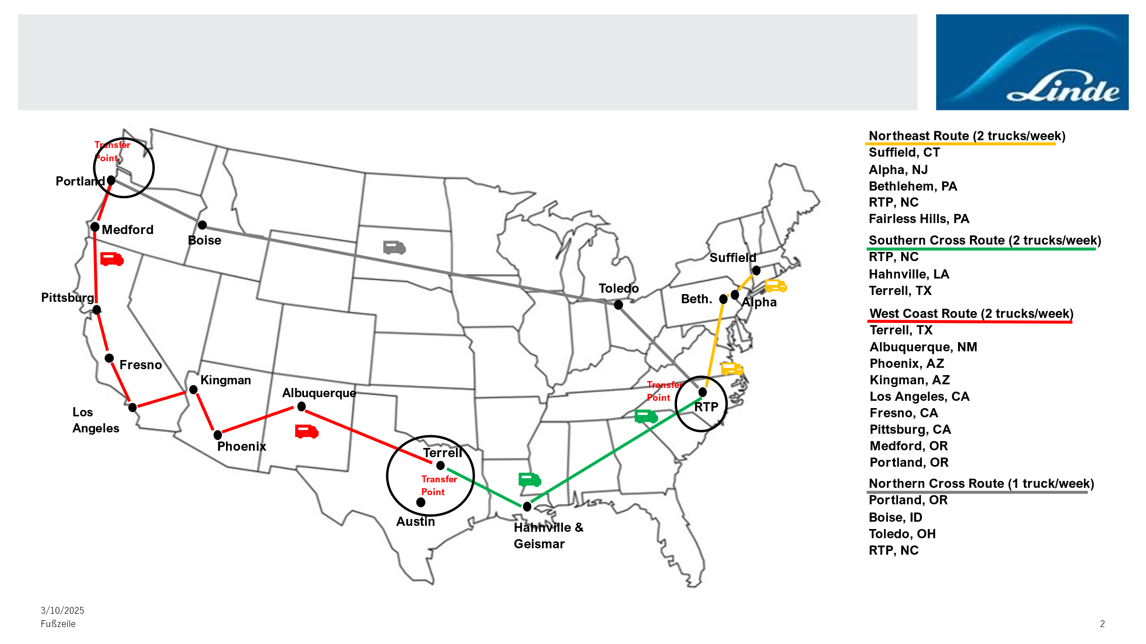
Electronics Warehouses and Truck Routes

Slide 5
SAP Process SMEs
Finance/Controlling
David Wright
Tax/AP/AR/Accounting: Elvir Alicic, Jessica Barloon
Operations Support: Vivian Ng
Commercial (OTC/PTP)
Inventory Management/Warehouse: Angela Radford
Brad Beesley
Teresa Follet
Tina Morse
Order to Cash: Peggy Lee
Pricing: Kevin Schmalz
Export/GTS: Yuliana Kalinova
Procurement: Derek Holtman
Operations
Product to Order: Angela Radford
Production Planning: Jeff Burnley
Raw Materials Inventory:
Mike Unangst
Gwen Owisney
Alfredo Meza
Quality: Courtney Martzen
Shipping/Receiving
Alfredo Meza
Kris Burgess
Victor Bardales
Assets: James Liebhart
Plant Maintenance Lead: Daniel Fiedler
Process Owner: Rene Garza

Slide 6
Key SAP Integrated Applications
Application | Description | Business Contacts | Technical Contacts
TLIMS | Metrology data from analyzers | Patricia Clarke, Lisa Moralez | Mark Douglass (Trinity Data Solutions)
Vertex | Tax | Mark Mezera, Tina Sylvester | Johannes Schneider Lazar
Prometheus | Plant Maintenance | Daniel Fiedler | Stuart Boyd
Exstream (Streamserve) | Billing | Kevin Schmalz | Stuart Boyd, Nathusingh Rathod
Evolve (Winshuttle) | Forms/workflow processes | Kevin Schmalz | Stuart Boyd
GTS | Export & trade compliance | Yuliana Kalinova | Martin Gall, Uwe Jung
EPP | Handheld cylinder scanning | Angela Radford | Stuart Boyd, Brendan Farthing
SRM | Procurement | Oscar Ramos | Stuart Boyd
MES (In development) | Production automation | Neil Cope, Won Bernhardt | Stuart Boyd

Slide 7
Appendix

Slide 8
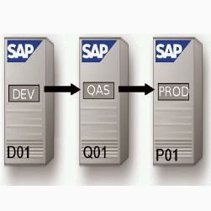

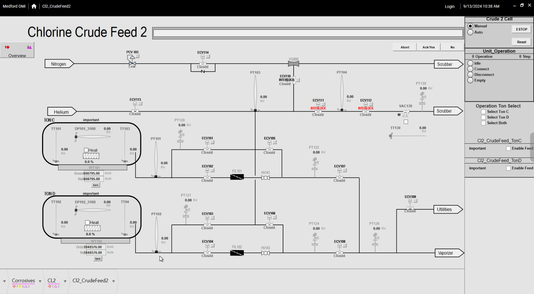
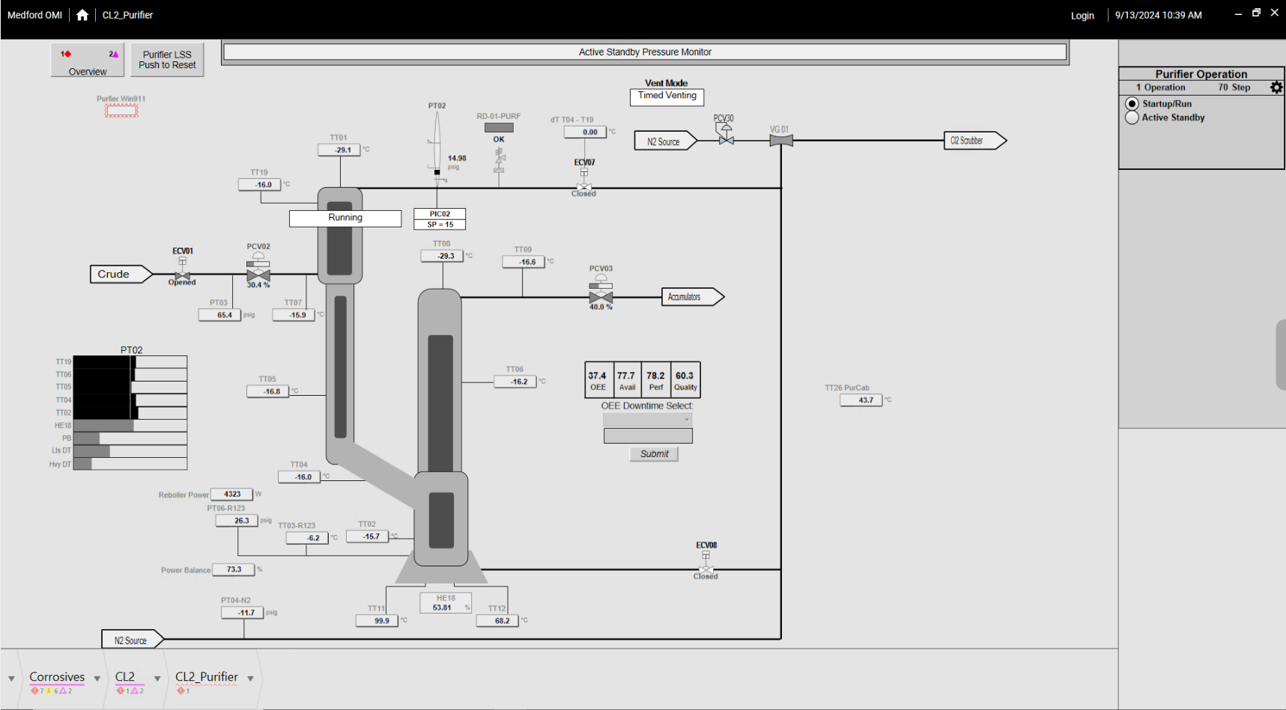
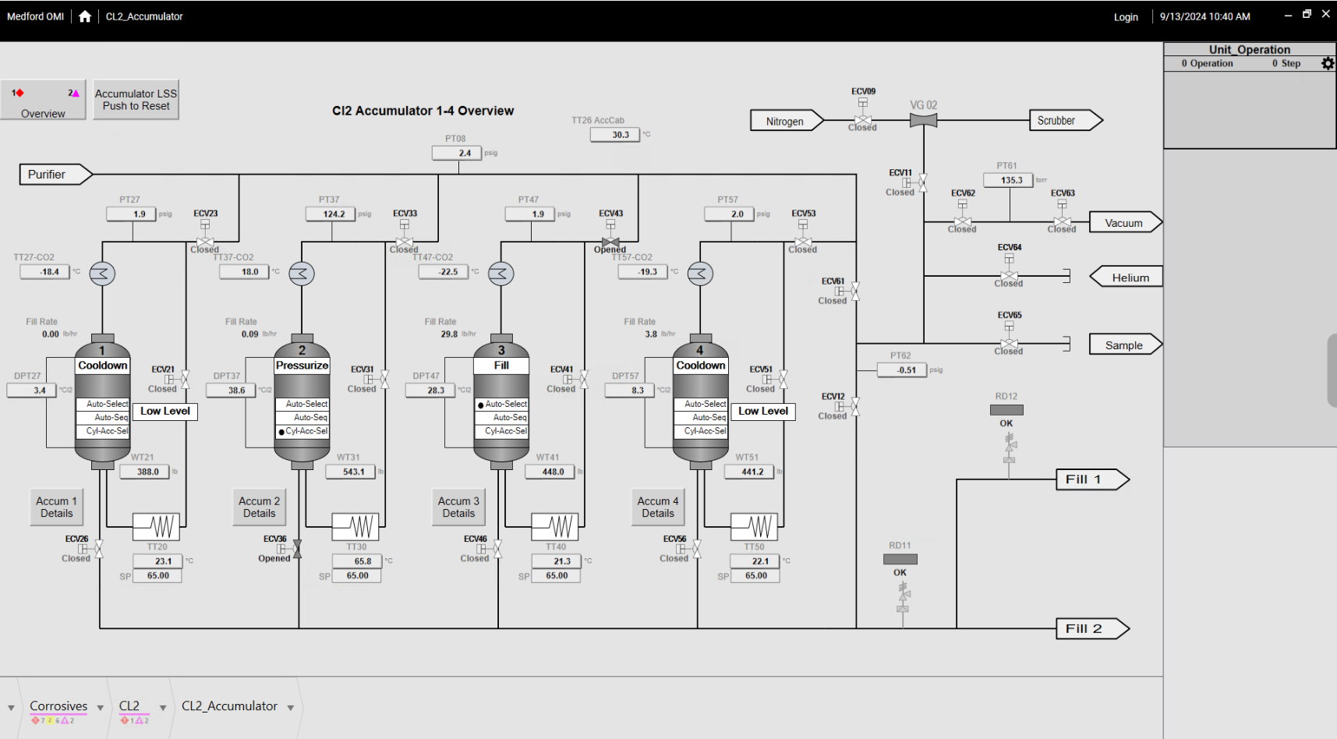
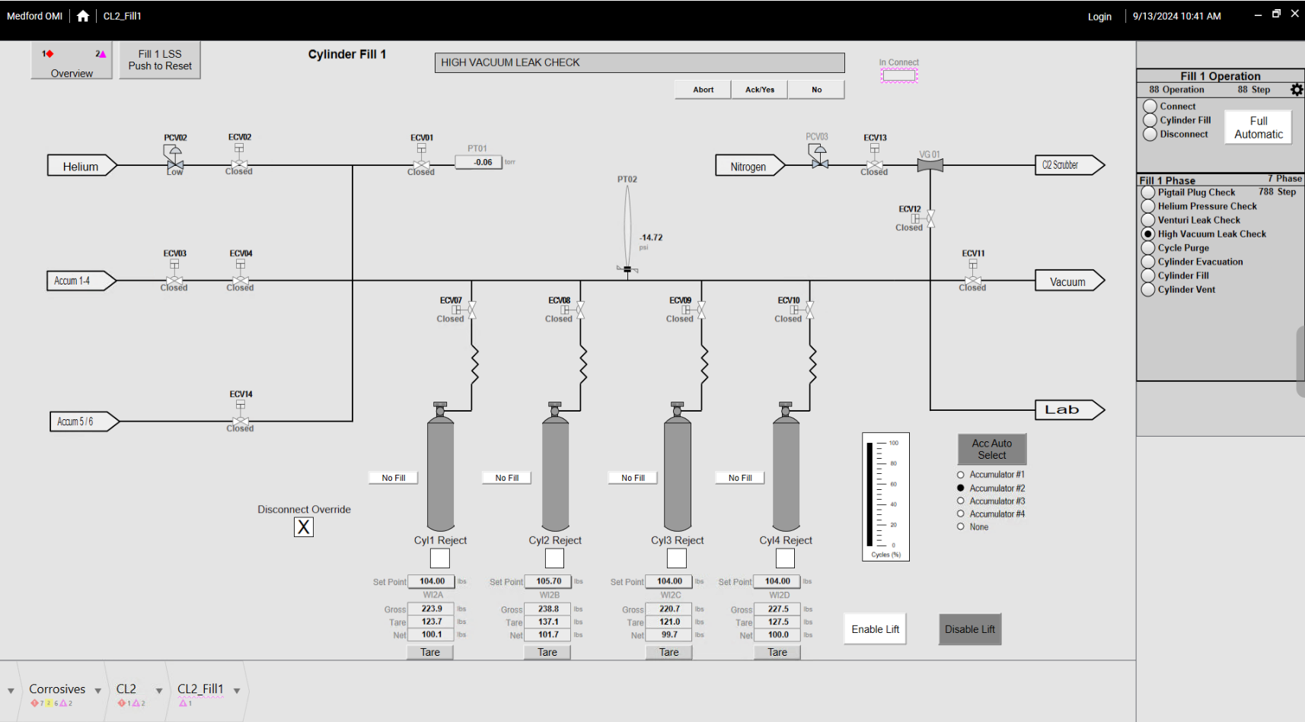
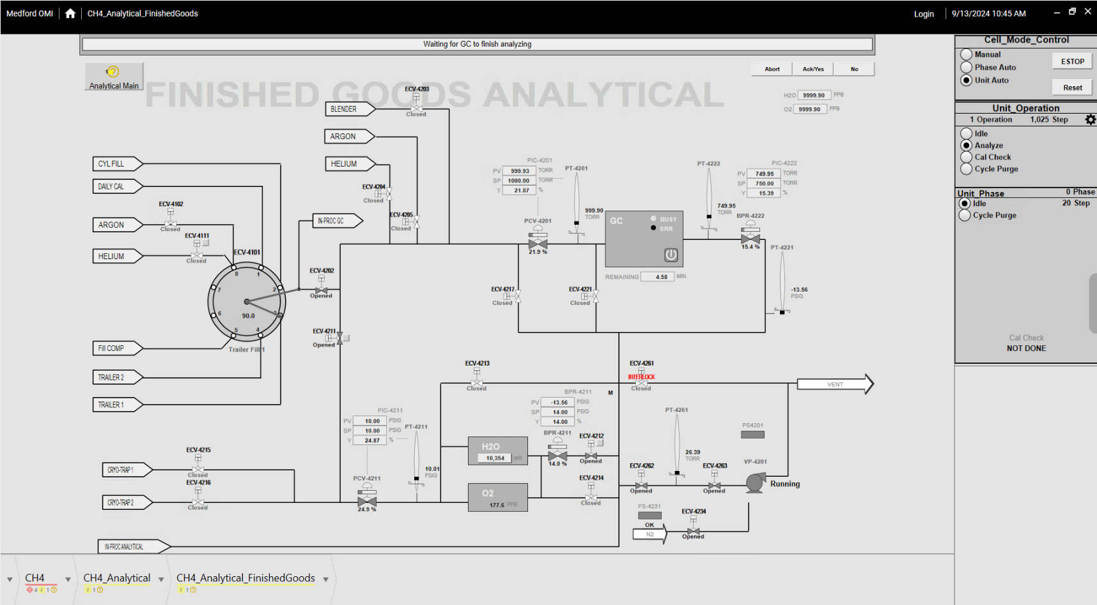
AVEVA MES
Bridging the Gap between Business Systems and the Production Environment
Enterprise Layer
Level 4
Production Order
Cylinder
Inventory
TLIMS Quality
Production data
ERP
ERP
Enterprise & Business Integration
Warh
LIMS
ERP
Enterprise Integrator
AVEVA MES
Inventory
Received, WIP, Produced,
Shipped
Production
Order / Job
Execution, BoM,
Recipe, Labor
Quality
Specifications
Sampling, SPC
Traceability
Materials, WIP Tracking & Tracing
Performance
OEE, Downtime,
Utilization
Scheduling
Distribution,
Priority,
Optimization
Work Tasks
Approvals, Rules, CA’s,
RCA’s Data Collection
BI Gateway
ETL, Aggregate &
Contextualize Data
Level 3
WorkTask
Reporting
Real-Time Data Platform
Level 2
AVEVA System Platform (existing)
Equipment Model Device Integration Automation Library Reuse
Object Wizards Diagnostics Visualization
Level 1
Crude Feed → Purification→ Accumulator → Fill → Analyze
Notes:
AVEVA MES is the Glue that brings together your Business systems and your Production environment
MES can grab sales orders from your ERP and translate those to jobs that need to be executed by your front line operators to meet customer demand.
As jobs are completed, It can then take information from the shopfloor like materials consumed, goods produced, and storage locations and push that information back up to your
Business systems for near real-time updates of production activity.
This seamless exchange of information between those tow primary systems, provides you will a more holistic view across your enterprise and empowering users to take action

Slide 9
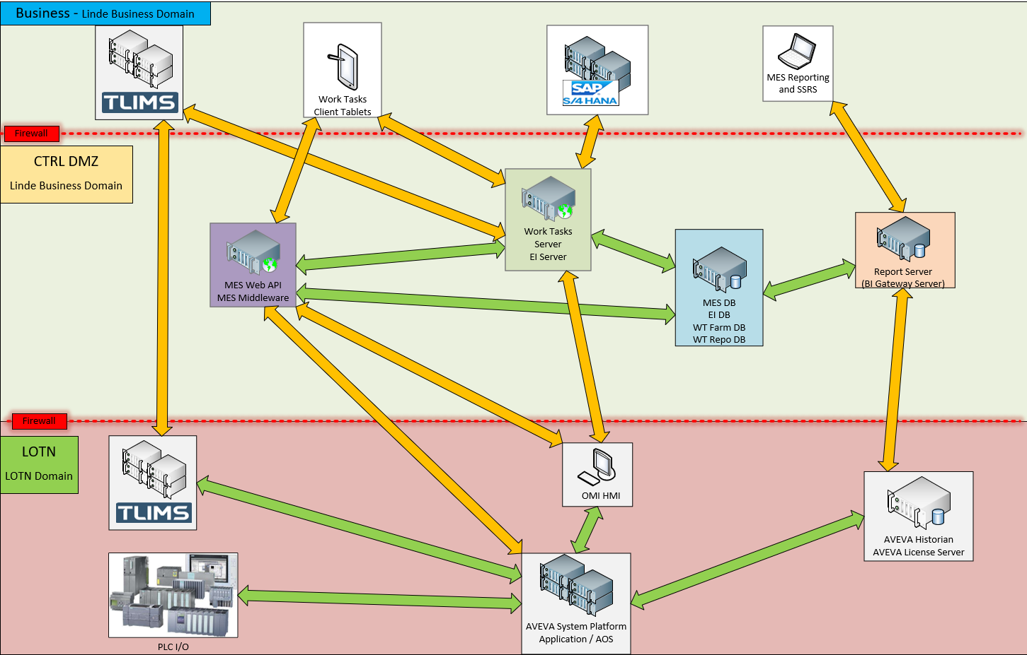
MES Infrastructure & Integration Topology
Notes:
All MES Servers will live at datacenter within a DMZ
Users will need to manage 2 different AD accounts depending on their interface (Tablet/OMI HMI)
MES DB and Report servers will require SQL Licensing.

Slide 10
Project S/4 HANA US & Mexico Organization
Project Streams
13.01.2025
To be established
S/4 HANA Program SteerCo
Biz Steer Co US
Americas IT JF
Mark Alexion (Sales), Bill Heintz (Ops), John J. Byrne (Commerce), Adam G. Schmidt (Finance) Pete Casazza, Derek Punaro, Stuart Boyd
Dulce Borjas, Pete Casazza, Adrian Espinosa, Michael Kurtz, Goran Cederwall, …
Denny Brown
Jason O’Brien, Danny Perri, Dulce Borjas, Michael Kurtz, Goran Cederwall, …
PM Core Group
Biz Steer Co Mexico
Derek Punaro, Rodolfo Ortiz Chavarin, Stuart Boyd, Stephan Domes, Natarajan Thiyagarajan, Sneha Dutta, Pete Casazza (optional), Adrian Espinosa (opt.)
Established
RBU Head, Head Finance, Operations, Deliver, Adrian Espinosa, …
Global
Program Manager
Stephan Domes
Deployment Manager
US
Deployment Manager
Mexico
Global
Deployment Manager
Derek Punaro
Rodolfo Ortiz Chavarin
Sneha Dutta
Integration Manager
Delivery & Integration
Stuart Boyd
Natarajan Thiyagarajan
BPO US
BPO Mex
Fico Team
Interfaces
Environment
Manager
Selective Data
Transformation
Finance & Controlling
Co-Ordinator
Finance & Controlling
Co-Ordinator
US – FICO, Stuart Boyd
MX – FICO
Rutuja RW, Pradeep K (E)
Leonard Eynon
Atanu Tripathy
Tobias Hust (Lead)
Anubhab D. (Functional)
David Wright
Enrique Mar
Supply Team
Authorization Lead
Test Lead
Infrastructure
Product to Order
Co-Ordinator
Product to Order
Co-Ordinator
US – Plant M., S Boyd
US – Procurement, MX – Plant M.
Anders E (Plant M), Shweta C (Proc) Gaurav B
US – Tracy Herbert
MX – Dario Hernandez
Corporate IT
Angela Radford
Carlos Fernandez
Pallavi Banerjee
Pravin Shetty
Order to Cash
Co-Ordinator
Order to Cash
Co-Ordinator
Sales Team
Data Migration
Corporate IT
Functional
SAP Authorizations
Peggy Lee
Enrique Mar
US – Sales OTC
Wolfram Schenker, Sudipto D
US – Nikki Nelson
MX – Martin Vega
Dave Hodson
Stephan Westenberger
Anubhab Dasgupta
Shweta Chaudhary
Gellert Kovacs
Regional Business
Procurement
Co-Ordinator
Procurement
Co-Ordinator
Cutover
Derek Holtman
Diana Martinez
Test Lead
US – Nikki Nelson
MX – no
Armin Pfeiffer
Interfaces
BW Reporting
Pallavi Banerjee
Leonard Eynon
Juergen Mohr
Pricing
Co-Ordinator
Pricing
Co-Ordinator
BW, Reporting
Hypercare
Development
Cut Over
Regional IT
Kevin Schmalz Jason Fawcett
Enrique Mar
US – Anne Leung
US – Derek Punaro
MX - no
Pankaj Agarwal
Armin Pfeiffer
Corp Resource , External local Resource

Slide 11
Project S/4 HANA US & Mexico Project – Corporate IT & External support for the Region
Corporate IT support for the Regional Team:
Team | Resource Details | Tasks | Expected Effort
Satellites | 1 Resource (US) | Satellite Connectivity Management across the project phases | 80 days
Functional | 2 Resources FICO (India, 1 external) 1 Resource Plant Maint (SE) 2 Supply (DE, India) 2 Resources Sales (1 SK external, 1 India) | Functional Support in MBP, Validation results review Functional Pre/post migration Manual Config Functional execution of baseline FUT/SIT scenarios based on scoping provided by region | FICO 215 days Pl Maint 77 days Supply 77 days Sales days 215 days
Testing | 1 Resource (US) | Test Management | 100 days
Cut Over | 1 Resource (DE) | Cut Over Management | 60 days
Project Management | 1 Resource (US) | Project Integration Management | 100 days
Total | 924 days across 11 Resources incl 2 externals |  | 240k USD external 75k USD Backfill for internals
External support for the Regional Team:
Team | Resource Details | Tasks | Expected Effort
Functional | 1 Resource FICO (US) 1 Resource FICO (Mexico) 1 Resource Plant Maintenance (US) 1 Resource Plant Maintenance (Mexico) 1 Resource Logistics (US) 1 Resource Sales OTC (US) | Define test cases Test execution & retesting US EPP solution testing - FUT to UAT Other processes - SIT, UAT execution Cut Over preparation | 7 months US Day Rate: 800 USD Mexico Day Rate: 300 USD
Project Management | 1 Resource PM (Mexico) | Project Management | 10 months Mexico Day Rate: 300 USD
Total | 7 Resources |  | 368k US (USD) 164k MX (USD)

